Slide 1
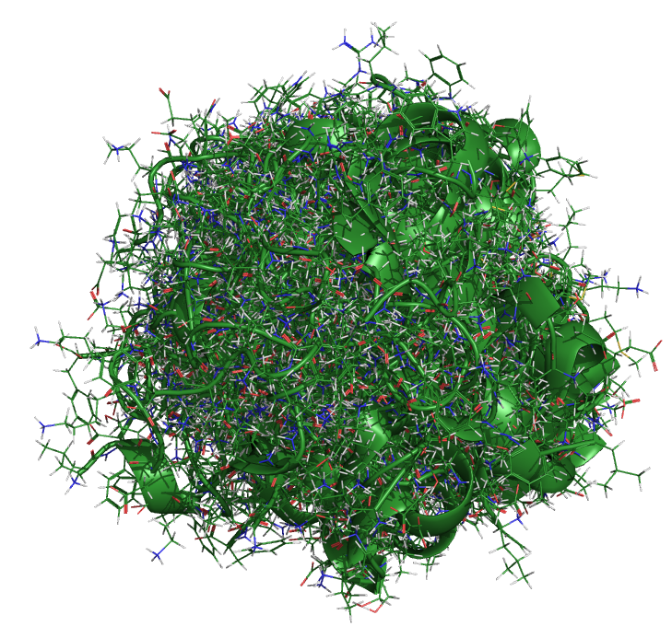
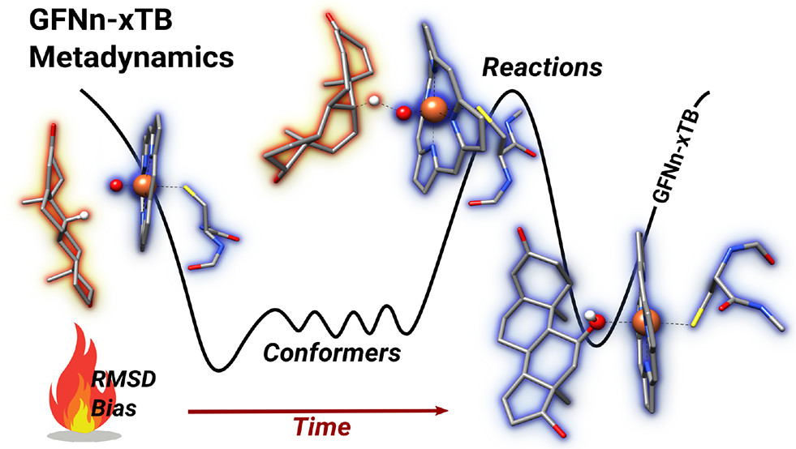

CREST and Conformational Searching
CAML 2024 Jaca, Spain
Heidi Klem – June 17, 2024

Slide 2
Core Computational Chemistry Methods
Density Functional
Theory
Molecular Mechanics
Semiempirical
Ab Initio
Classical mechanics
Computationally inexpensive
Parameterized force fields
Quantum mechanics-ish
Based on Schrödinger equation
Parameterized with empirical data
Quantum mechanics-ish
Based on Schrödinger equation
Electron density rather than wavefunction
Quantum mechanics
Schrödinger equation
Approximations required
1998 Nobel Prize in Chemistry
John Pople “for his development of computational methods in quantum chemistry”
Walter Kohn “for his development of the density functional theory”
2013 Nobel Prize in Chemistry
Martin Karplus, Michael Levitt, and Arieh Warshel “for the development of multiscale models for complex chemical systems”

Slide 3
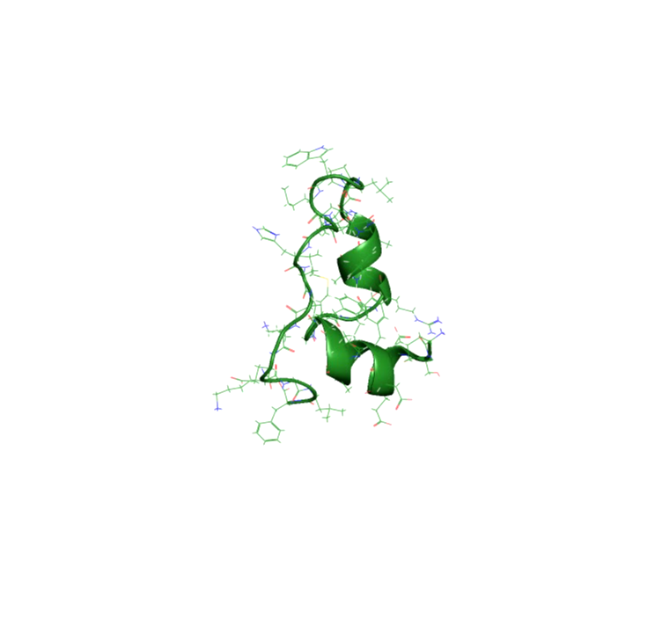
“Everything that living things do can be understood
in terms of the jiggling and wiggling of atoms”
- Richard Feynman
Snapshots from a 105 µs trajectory
Chicken villin heapiece-35 (HP35)
Simulation by D.E.Shaw Research
Notes:
Atoms are in perpetual motion (because absolute 0 in Kelvin is theoretical).

Slide 4
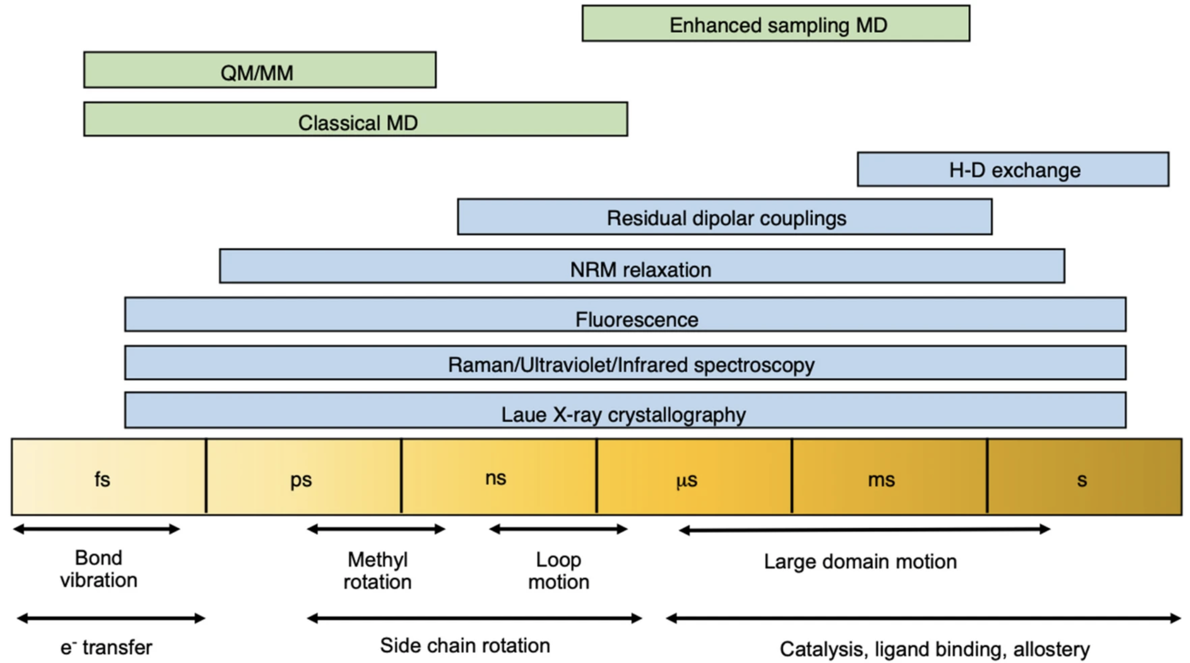
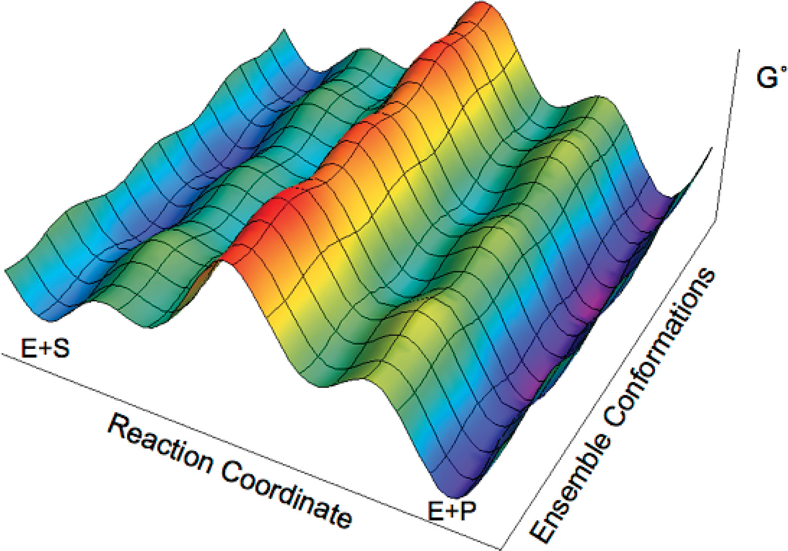
Molecular Motions
Multiple populations of conformations, intermediates, and transition states can exist.
Consider macroscopic/bulk
vs. microscopic
Notes:
Potential energy surface: describes the relationship between molecular geometry and energy
Conformational analysis is one of the central topics in computational chemistry.

Slide 5

How can we model chemistry consistent with experiment?

Slide 6
Clarifying terminology
Geometry versus Conformer
Stochastic
versus
Systematic

Slide 7
Stochastic approach
Molecular dynamics (time evolution of atomic positions) to explore conformational landscape
Goal is to sufficiently sample phase space to directly obtain the Boltzmann weighted conformational ensemble
represent geometric distributions that represent the experimentally relevant conformational ensemble
Applications to large molecules (well beyond 500 atoms)

Slide 8
Example: protein folding
Structural clustering can be used to identify and quantify stable conformations
The resulting discretized trajectory data can be used with Markov State Modeling to recover the equilibrium properties of a process.

Slide 9
How can we model chemistry consistent with experiment? How can we do this accurately and efficiently?

Slide 10
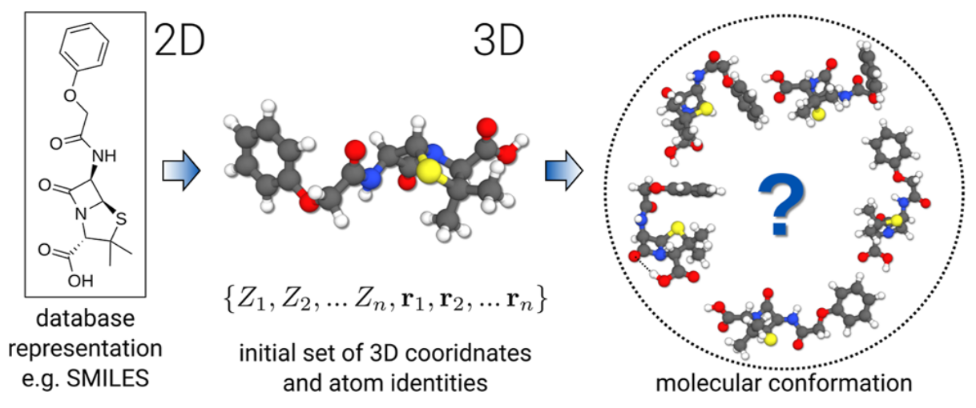
Systematic approach
Goal is to identify lowest energy conformers that represent the experimentally relevant conformational ensemble
Better suited for small molecules ( < 500 atoms) often involving iterative procedures
Calculations performed on minimized conformers and results are Boltzmann averaged
Depending on the size of the molecule, it might be possible to figure out all possible conformers
Heuristic or physics-based

Slide 11
Conformational analysis
Can be computationally demanding depending on the accuracy you seek
Intelligently designed workflows, often involving multiple optimization rounds, can reduce the computational demand
Automation can promote reproducibility and reduce headaches!
A VERY general workflow might look like:
1. Efficiently and broadly generate geometries
2. Fast geometry optimization and rank resulting conformers
3. Remove duplicates, select subset and reoptimize to refine ranking

Slide 12
Gets-the-job-done optimization
ANI-1
Accurate NeurAl network engine for Molecular Energies
Deep neural network train on QM DFT calcs
Applies only to HCNO atoms
GAFF
General Amber force-field
Parameterized for small organic molecules
GFN-FF
Generic polarizable force-field of the GFN family of methods
All elements up to Radon
GFN2-xTB
Geometries, Vibrational Frequencies, and Noncovalent interactions
eXtensions in the AO basis set using density functional Tight Binding methods (tight-binding DFT)
All elements up to Radon

Slide 13
CREST
Conformer-Rotamer Ensemble Sampling Tool
For energy calculations and geometry optimizations, CREST uses either force field or semiempirical methods.

Slide 14
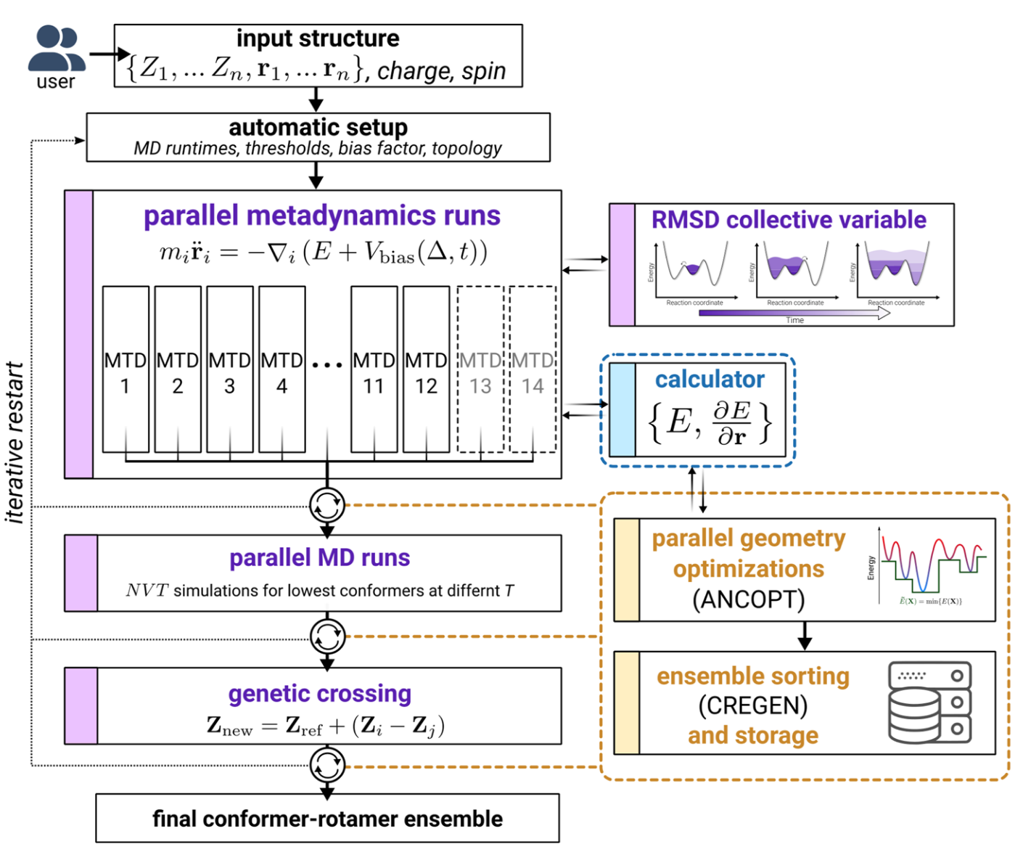
CREST iMTD-GC workflow
But first- let’s open up a Jupyter Notebook and get a calculation running, then we will talk about the procedure as it runs.
Parallel runs to vary parameters in the bias potential
MTDs are well-suited to cross high-barriers, at the cost of missing some small-barrier changes
So MD runs are performed at two different temperatures on usually the lowest 4 confs found so far, to target rotamer sampling
Rotamer sampling is augmented by use of a GC algorithm to introduce “mutations”
The confs generated at each stage are reoptimized using the Approximate Normal Coordinate OPTimizer (ANCOPT) algorithm and if at any point a new lowest energy conf is found the process is restarted.

Slide 15
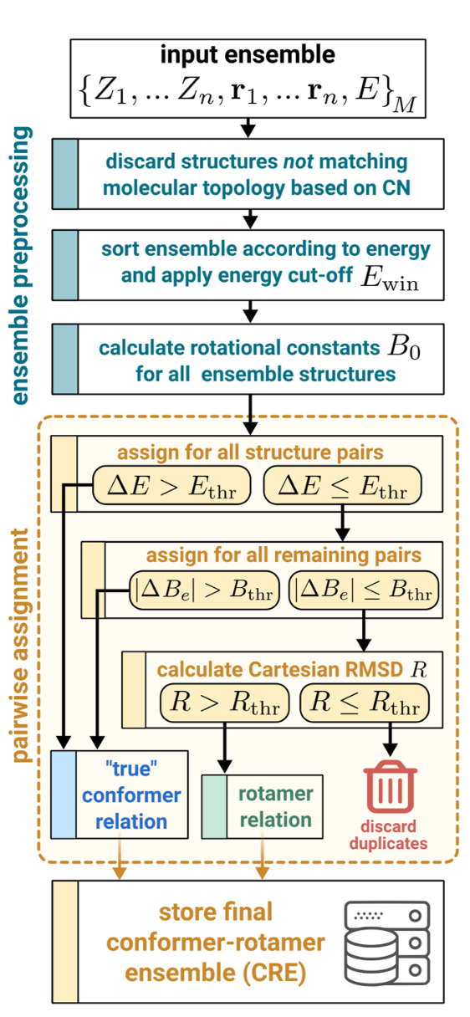
CREGEN
iMTD-GC workflow does really well at broadly traverses the conformational landscape, but maybe jumps high-energy barriers too well, missing smaller conformational changes in bond rotations.
Conformer–Rotamer Ensemble GENeration (CREGEN) is implemented in CREST to aid in the identification of conformers, their associated rotamers, and duplicated structures.

Slide 16
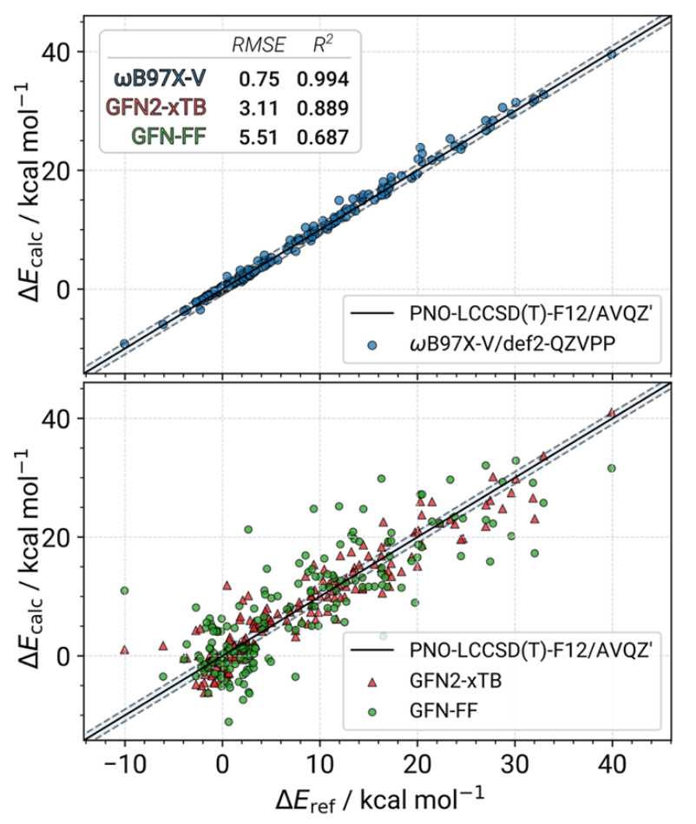
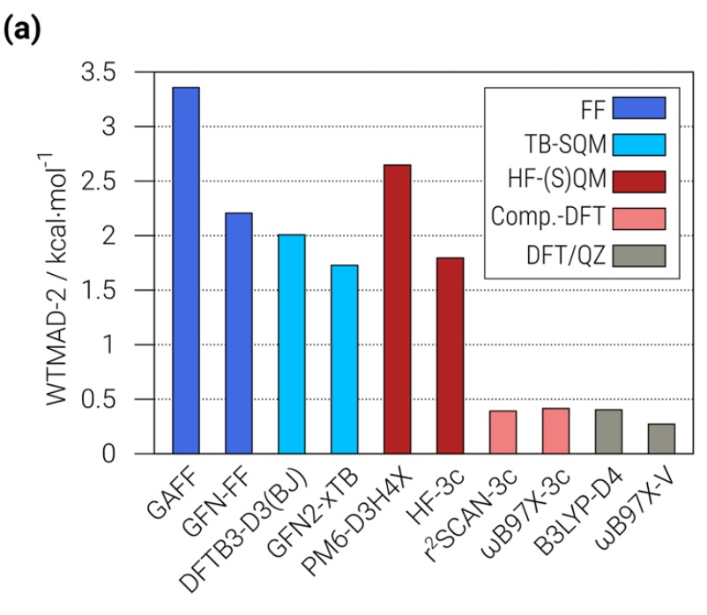
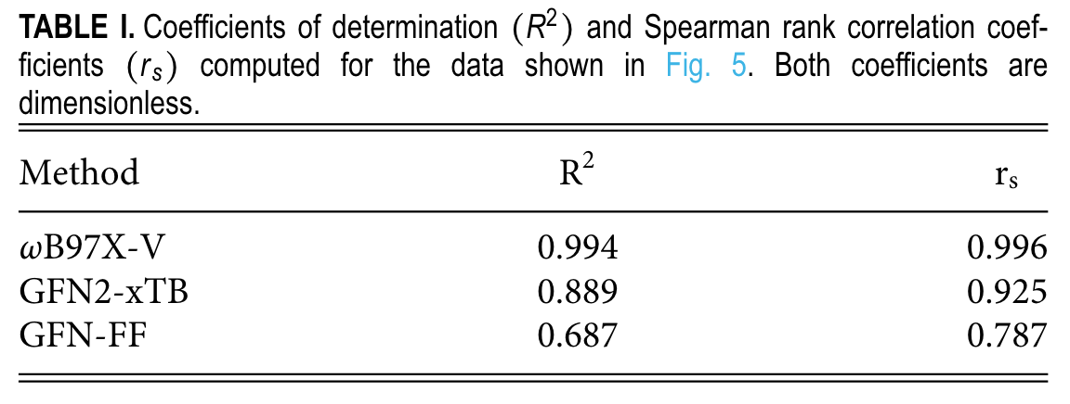
CREST benchmarking
GFN2-xTB
Conformational energies are more accurate than HF-S(QM), and less accurate than composite DFT methods
Much faster, and perform well in correctly ordering the conformers

Slide 17
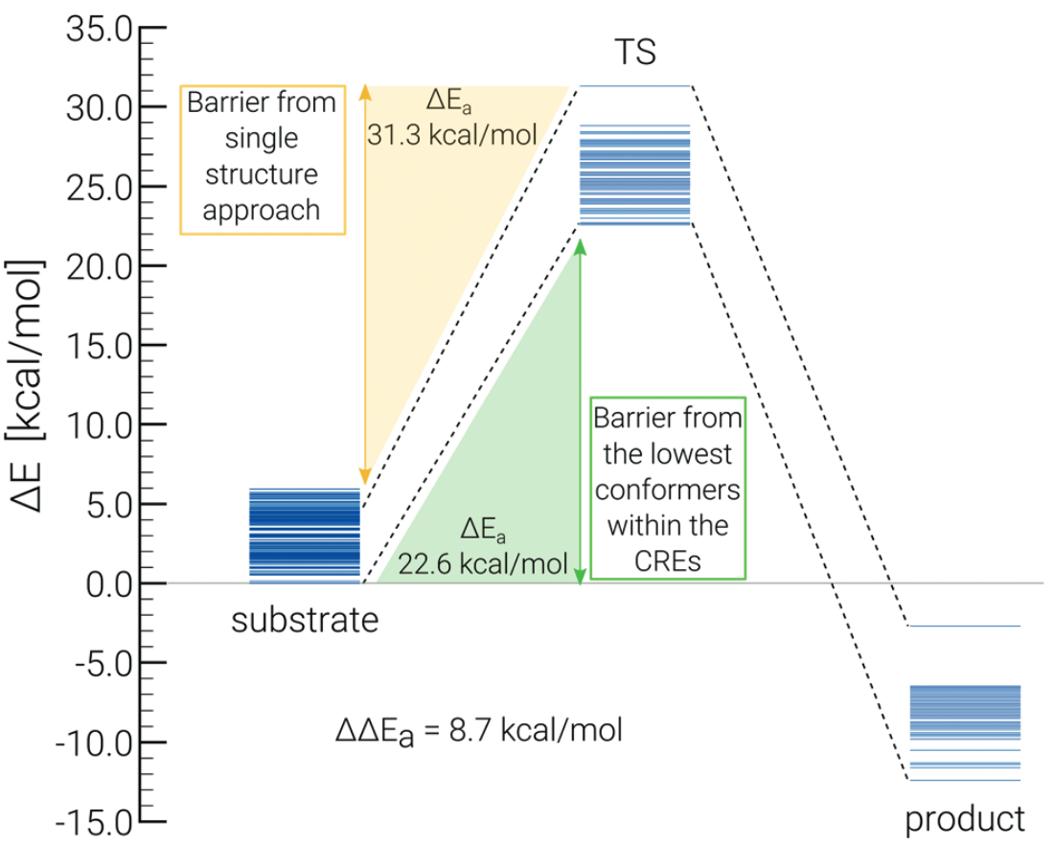
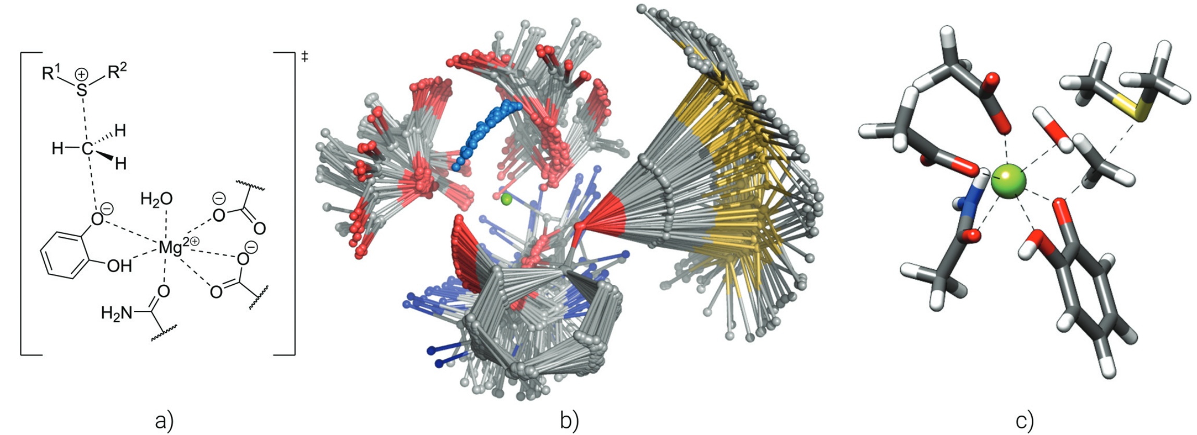
Constraints and non-covalent complexes
an ellipsoidal potential can be used to encapsulate the studied complex and avoid problems due to the metadynamics bias which, by maximization of the RMSD due to increasing the distance between the non-covalently bound fragments, would minimize the energy and hence only generate dissociated clusters. A dedicated non-covalent interaction (NCI) runtype, called NCI-MTD, is implemented in CREST to automatically set up the ellipsoid potential and slightly modify the bias potential parameters.
as opposed to previous program versions, CREST 3 implements the complete freezing of atoms in all metadynamics simulations and geometry optimizations

Slide 18
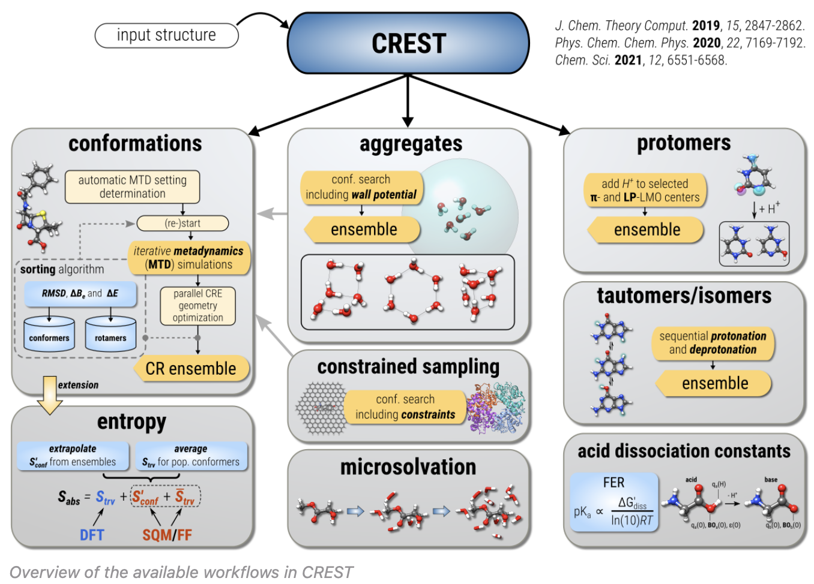
CREST ecosystem

Slide 19
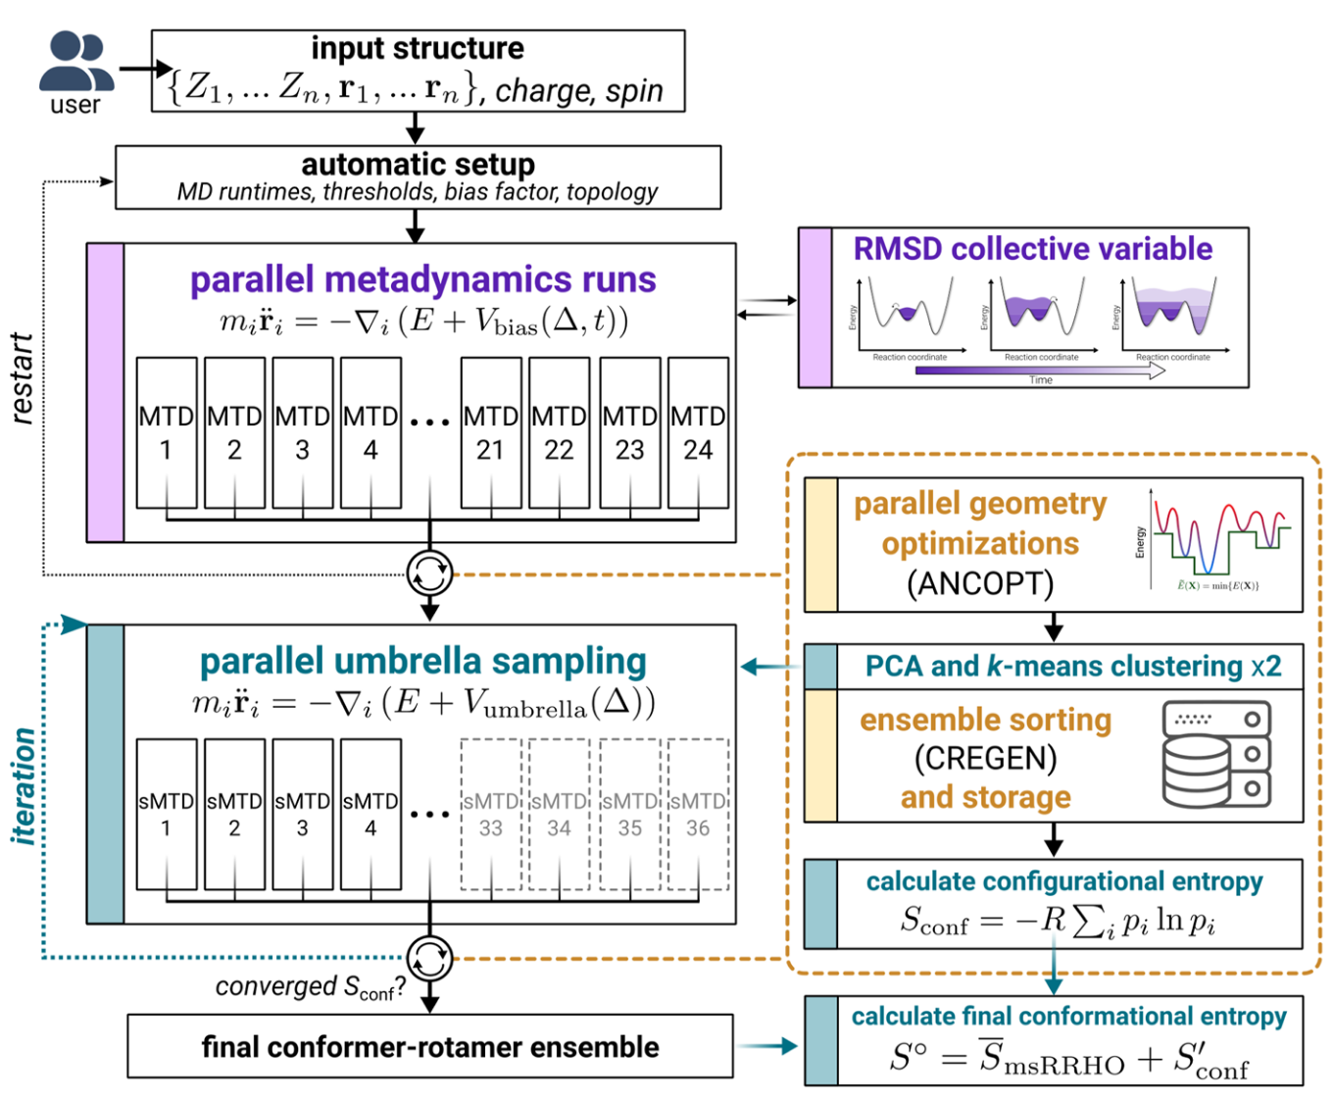
New and improved features in CREST 3.0
Iterative metadynamics–static metadynamics (iMTD-sMTD) workflow used to calculate the configurational entropy.
TOML based configuration files instead of just command line (significantly improves interoperability).
Stand alone single-point energy and gradient evaluation available with --sp flag
Stand alone geometry optimization available with --opt or --ancopt flag
Can someone please write an entropy related script called entro.py?

Slide 20
Discussion points
Is the lowest energy conformer sufficient? How can you support that? Experimental data is our friend.
What assumptions are being made? If you are truncating the system for ease of calculation, is the resulting conformational space adequately similar? Constraints!
Starting structure bias
There is no one-size-fits-all solution, unfortunately. (show web-plot from 2024 CREST paper comparing different approaches in different benchmarking sets.
Similar to TS searches, conformational searching is an art
IMO CREST is broadly applicable: very approachable for new students, highly adaptable for complex situations, interoperable/modular (CREGEN), open-source and going-strong.
Anyone have a fun/ugly/cool/ conformational-analysis related research story to share?

Slide 21
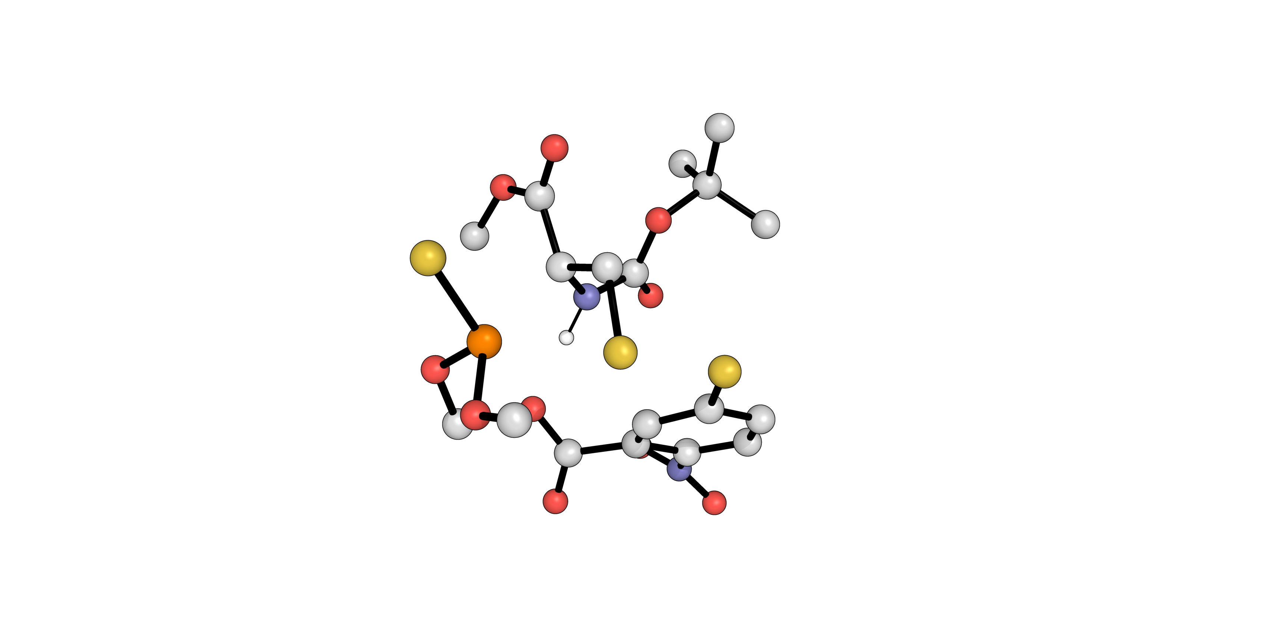
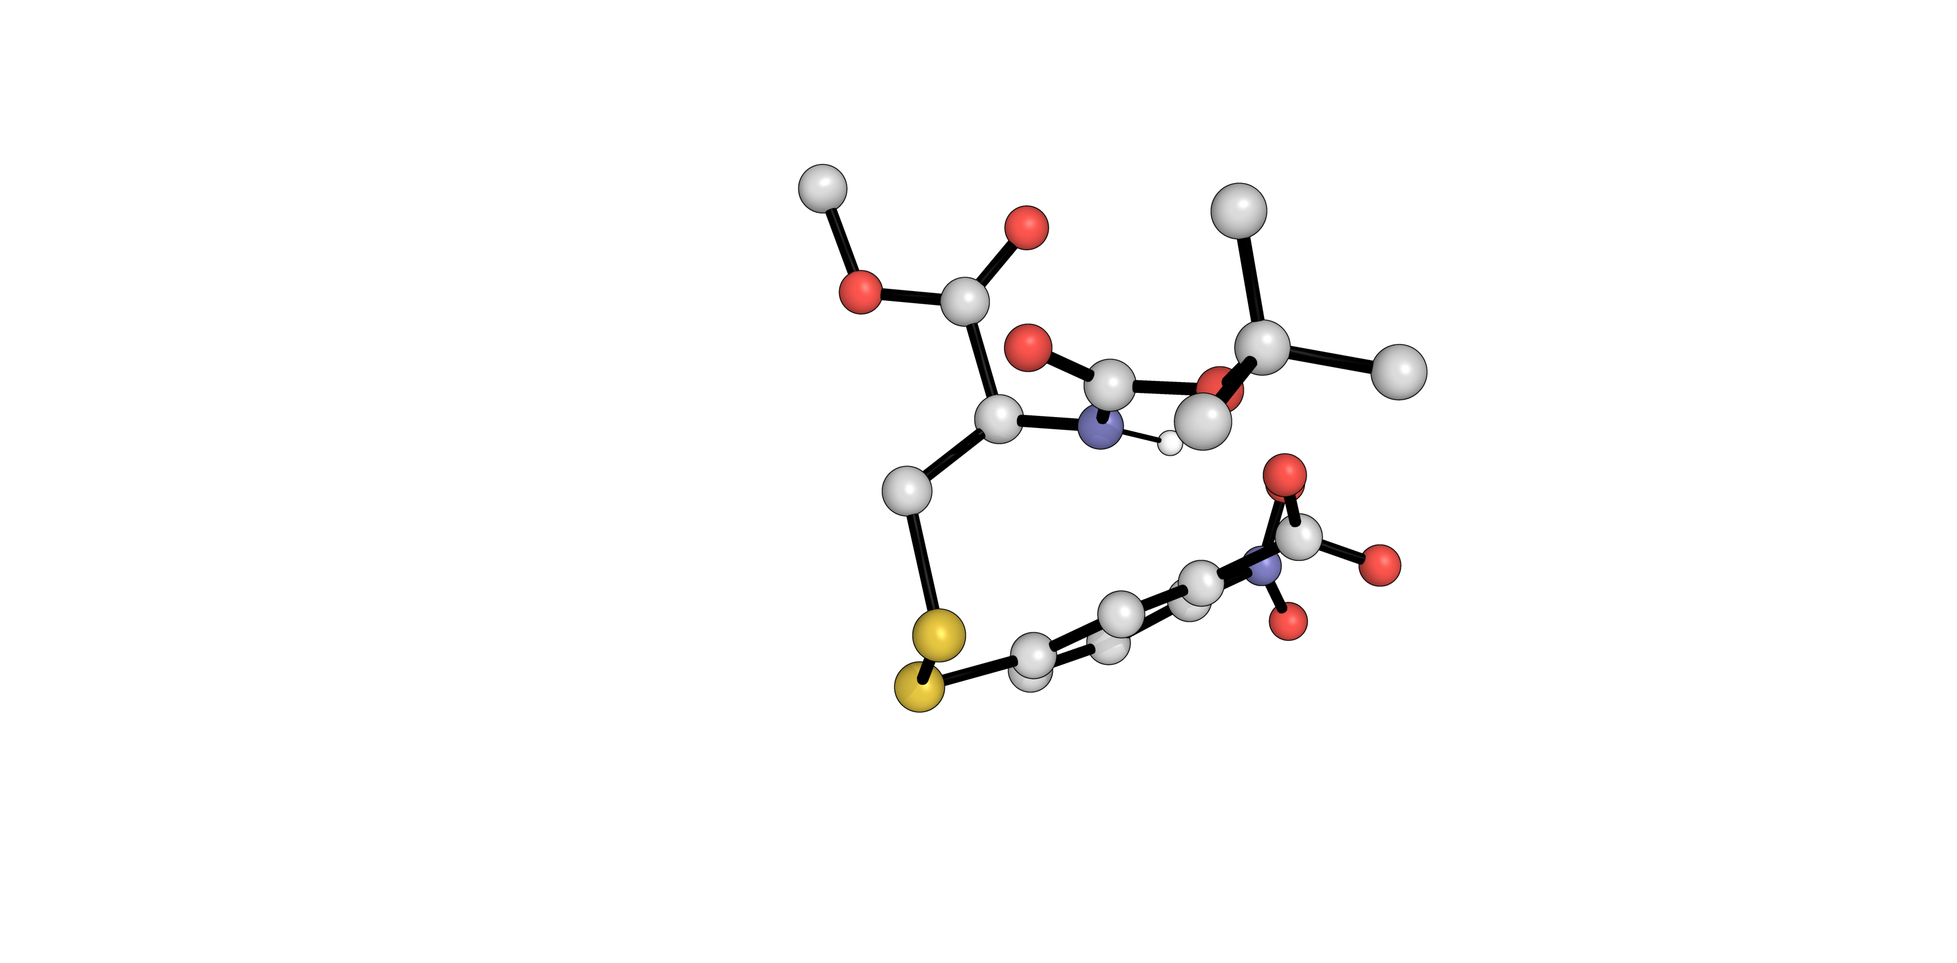
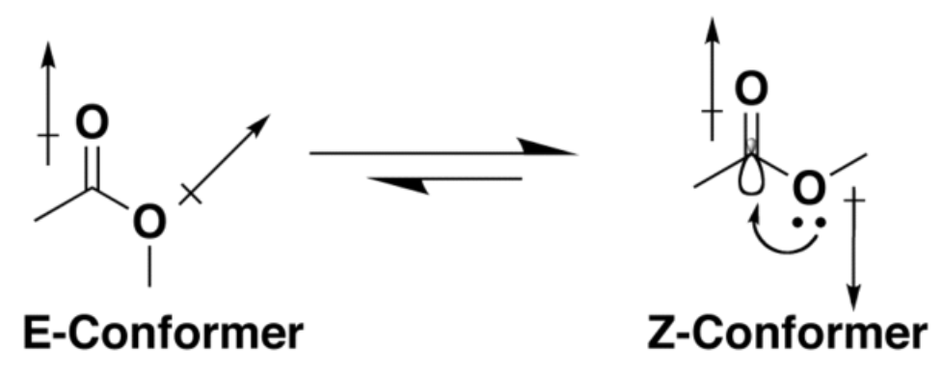
Example: barrier height predictions
We investigated the activation energy barriers for various other substrates using a truncated system
Starting Materials (SM)
Products
TS
lowest energy conformer in SM:
lowest energy conformer in TS:
Z-conf
E-conf

